Slide 1
Online Purchasing Behavior Prediction
Student Name: Ishita Patel
Student ID: 501326439
CIND820: Big Data Analytics Project Tamer Abdou, Ph.D.

Slide 2
Dataset Information
"Online Shoppers Purchasing Intention" retrieved from UCI machine learning repository.
The dataset provides insights into consumer clickstream activity, demographic details, and time-related patterns.
No missing data
12,330
10
8
Online shopping
sessions
Numerical
variables
Categorical
variables

Slide 3

Goal
Predict the shopping intent of website visitors.
Purchase.
No purchase
Create and train a model which will be able to predict behaviors that lead to successful purchases

Slide 4
Methodology
Data Balancing/ Sampling
Feature Selection Methods
Data Scaling Methods
Cross
validation
Methods
Model tuning/ additional metrics
PCA Applications
Notes:
Data Balancing / Sampling
Addressed class imbalance using SMOTE to create a balanced dataset for better model performance.
Feature Selection Methods
Identified important predictors using Random Forest feature importance to reduce complexity and improve model interpretability.
Data Scaling Methods
Applied StandardScaler to normalize numerical features, ensuring consistent scaling for model accuracy.
Cross-Validation Methods
Used K-fold cross-validation to evaluate model performance and minimize overfitting.
Model Tuning / Additional Metrics
Performed Random Search.
Evaluated models using metrics such as accuracy, precision, recall, F1-score
PCA Applications
Implemented PCA to reduce dimensionality, retaining essential components and improving computational efficiency.

Slide 5
Data Balancing/ Sampling
SMOTE provided a balanced trade-off with an accuracy of 86% and F1-scores of 0.92 (negative class) and 0.57 (positive class).
SMOTE was chosen as the data balancing method
Notes:
Techniques Evaluated
Compared SMOTE, oversampling, and undersampling using a decision tree model.
Results assessed using F1-scores, accuracy, and processing time.
Results
Oversampling: Highest accuracy (88%) with F1-scores of 0.93 (negative) and 0.60 (positive).
SMOTE: Balanced trade-off with accuracy (86%) and F1-scores of 0.92 (negative) and 0.57 (positive).
Chosen Method
SMOTE selected for its balanced performance, alignment with literature, and reliable positive class prediction.

Slide 6
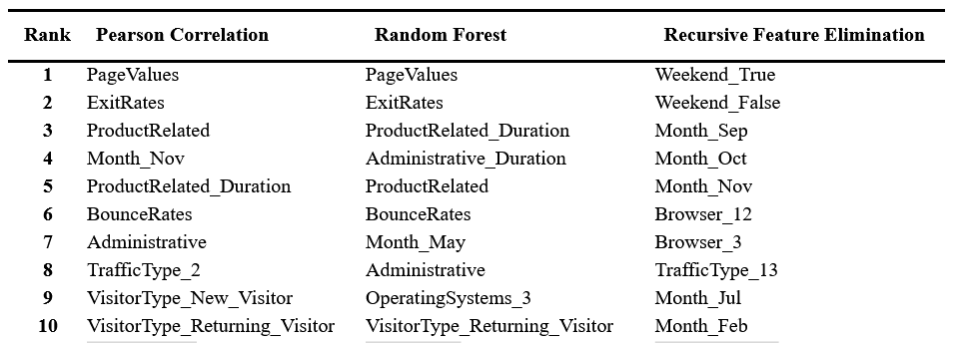
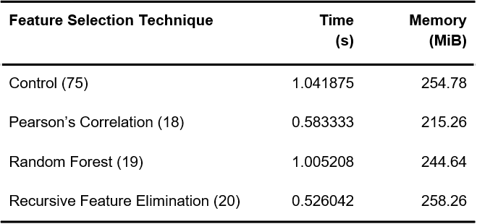
Feature Selection
Notes:
Techniques Evaluated
Pearson Correlation, Random Forest, and Recursive Feature Elimination (RFE) compared against a control group with all features.
Performance Metrics
Time (s): RFE was the fastest (0.526 s), followed by Pearson Correlation (0.583 s).
Memory (MiB): Pearson Correlation was the most efficient (215.26 MiB).
Chosen Method
Random Forest selected for robust feature ranking and alignment with model objectives.

Slide 7
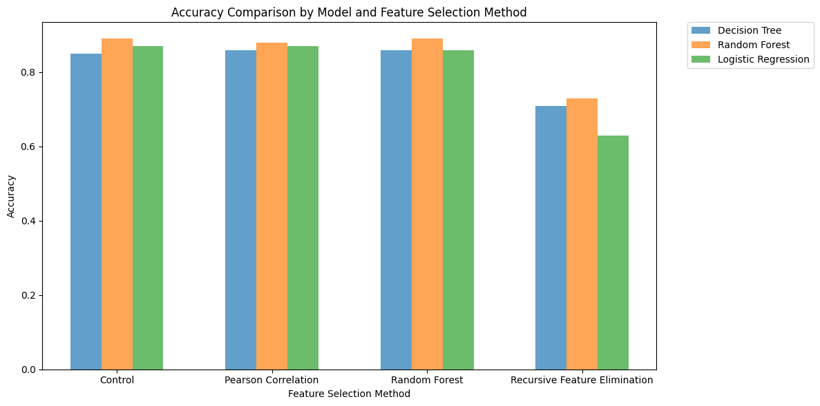
Notes:
Feature Selection Performance
Pearson Correlation: Improved accuracy for Logistic Regression and Random Forest models.
Random Forest Selection: Delivered the best accuracy across all models, especially for Random Forest and Decision Tree.
Recursive Feature Elimination (RFE): Achieved moderate accuracy, outperforming the control group but trailing behind other techniques.
Key Insight
Random Forest feature selection consistently enhanced model accuracy, making it the preferred method.

Slide 8
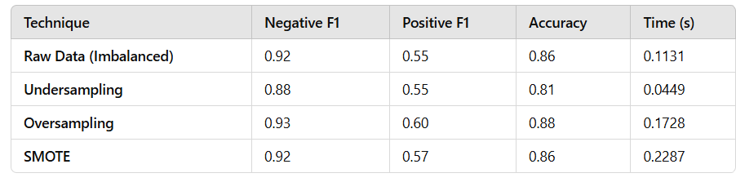
Results - Data Balancing
Best Performing Technique: Oversampling achieved the highest accuracy (88%) and a strong positive class F1-score (0.60) while maintaining high negative class performance (F1: 0.93).
Chosen Method: SMOTE was selected for its balanced trade-off, achieving high negative class performance (F1: 0.92), reasonable positive class F1-score (0.57), and alignment with established research practices.

Slide 9
Results - Cross-validation
Notes:
Cross-validation Methods Compared
No Cross-validation: Lower Positive Class F1-score.
K-Fold Cross-validation: Achieved the highest Positive Class F1-score, indicating better generalization and model performance.
Time-Series Cross-validation: Slightly lower F1-score than K-Fold but still better than "No Cross-validation."
Feature Selection Impact
Pearson Correlation and Random Forest: Both feature selection methods resulted in higher Positive Class F1-scores compared to the control group.
Control Group Performance
The Control group, without feature selection or cross-validation, showed the lowest F1-score.
Key Insight
Cross-validation (especially K-Fold) significantly improved the Positive Class F1-score, and applying feature selection further enhanced the model's predictive performance.

Slide 10
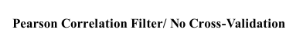
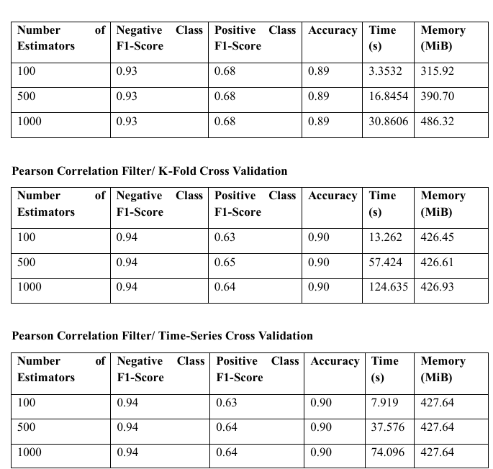
Results - Model Tuning
The model without cross-validation techniques achieves a higher recall for the positive class and a superior Matthew's correlation coefficient. This indicates that the model is better at correctly identifying transactions likely to result in a purchase.

Slide 11
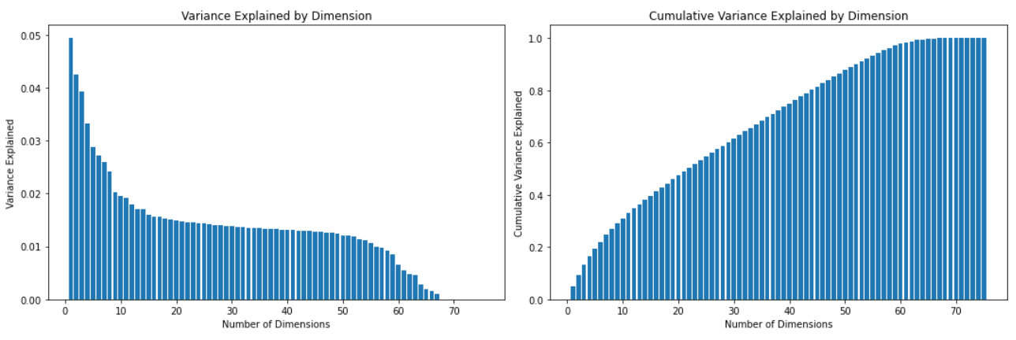
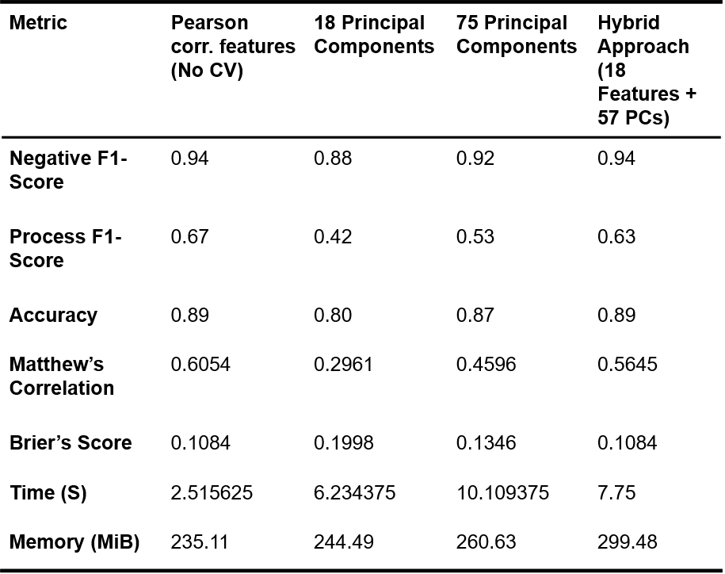
Results - PCA
Notes:
Performance Comparison
Principal Components showed strong performance with high Negative F1-Score (0.94) and Positive F1-Score (0.92), along with a notable accuracy of 0.67.
Hybrid Approach
The Hybrid approach provided a balanced trade-off, improving the Matthew's Correlation (0.63) and lowering Brier's Score (0.53), but with a slight increase in processing time and memory usage.
Resource Efficiency
The Hybrid approach consumed more resources, taking 10.11 seconds and 260.63 MiB of memory, while the 18 principal component approach required less time (2.52 seconds) and memory (235.11 MiB).

Slide 12
Conclusion
Developed a Random Forest model with robust preprocessing techniques, including SMOTE, data standardization, and feature selection using Pearson’s correlation.
Implemented methods optimized for environments with limited computational resources, balancing model performance with processing efficiency.
Experimented with advanced techniques like cross-validation and PCA, ensuring reliable evaluation and dimensionality reduction.
Model provides actionable insights for website designers and product marketers to enhance user experience and conversion rates.
Recognized limitations such as sensitivity to hyperparameters and challenges with computational resources, highlighting areas for future improvement.

Slide 13
THANK YOU

